Slide 1
Claude Shannon
The Father of information theory and the digital Revolution

Slide 2
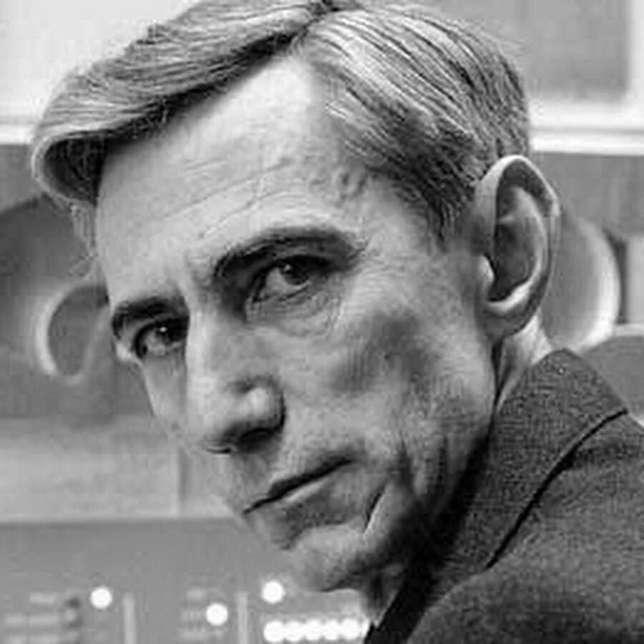
Who is Claude Shannon?
Profession: Mathematician, engineer, cryptographer
Years of life: 1916-2001
Key achievements:
Founded the theory of information (1948)
Proved that any data can be encoded with bits (0 and 1)
Created the first theory of digital circuits

Slide 3




The basic idea:
Information can be measured (in bits) and optimized.
Application:
Data compression (ZIP, MP3)
Noise-resistant codes (Wi-Fi, cellular communication)
Cryptography (SSL, Bitcoin)

Slide 4
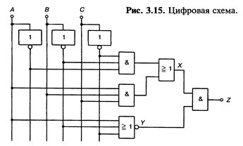
Digital circuits and Boolean algebra
Master's thesis (1937):
Proved that logical operations (AND, OR, NOT) can be implemented using relays and switches.
He laid the foundations of processor design.
Without this, there would be no computers!

Slide 5
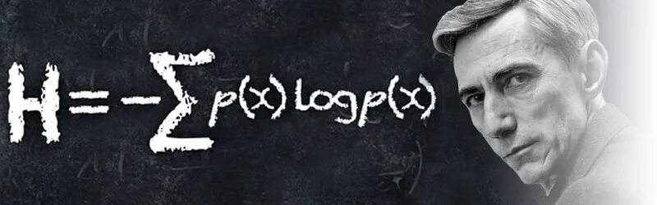
Shannon's Legacy
The Shannon Prize is an analog of the Nobel Prize in IT.
His channel bandwidth formula is the foundation of telecommunications.

Slide 6
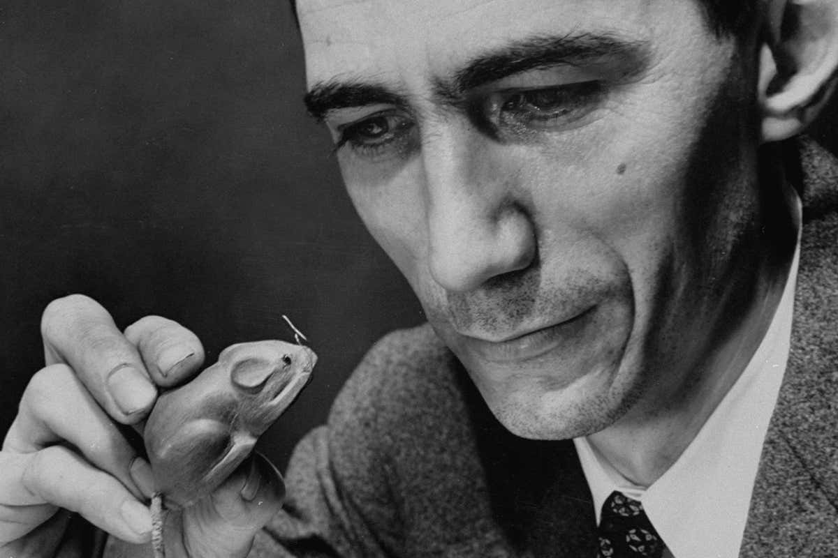
Interesting fact
He loved to juggle on a unicycle.
He created the first learning machine, the Theseus mechanical mouse, which found a way out of the maze.
He predicted that computers would be able to beat people at chess (and even proposed an algorithm in 1950!).

Slide 7
Conclusion
Claude Shannon turned information into science, and his hobbies into inventions.
"The purpose of science is to explain, predict and surprise«
— Claude Shannon

